Slide 1
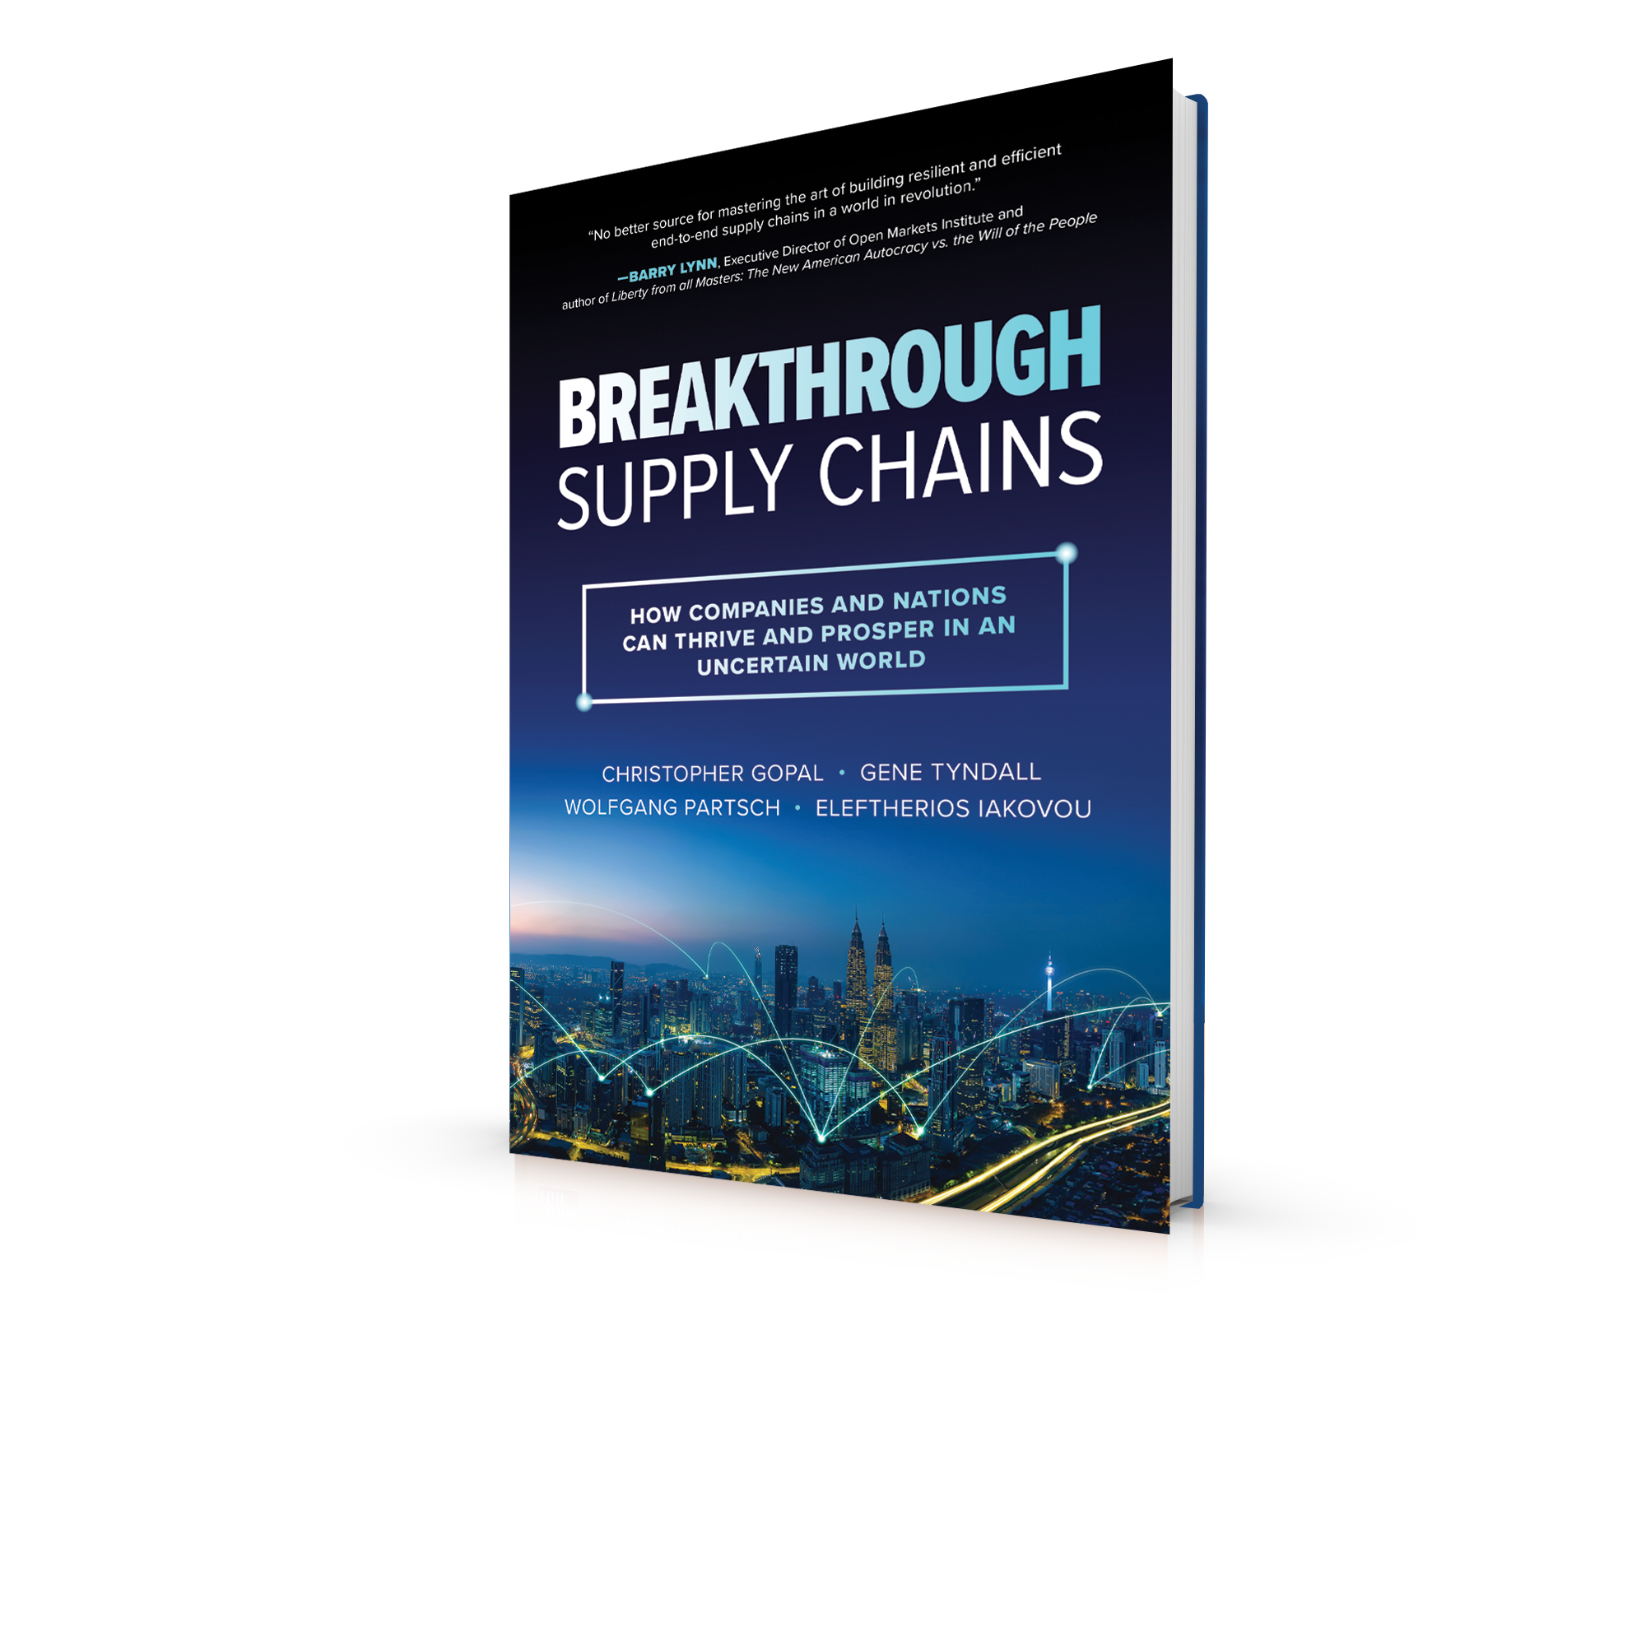
Breakthrough Supply Chains: How Companies And Nations Can Thrive And Prosper In An Uncertain World Gopal, Tyndall, Iakovou, Partsch ISBN: 978-1-264-98966-9 • e-ISBN: 978-1-264-99188-4

Slide 2
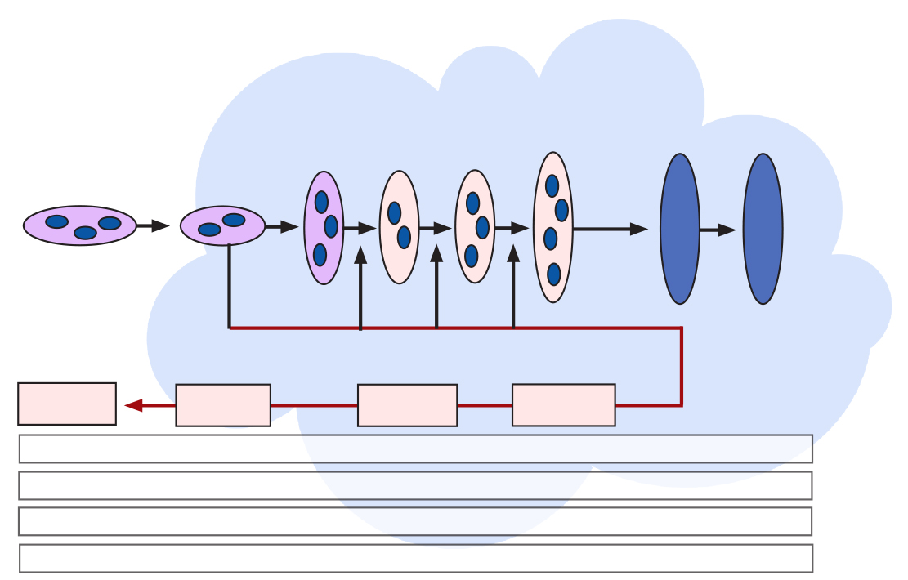
The Holistic End-to-End (E2E) Supply Chain– a “systems” perspective
Supply
Operations
Demand
Channel Regional DCs
Fulfillment Centers
Manufacturing
CMs, ODMs
Co-Packing
Conversion
Customer DCs
Fulfillment Centers
Inbound DCs
Suppliers 2-n
Tier 1 Suppliers
B
C
Final Mile
Network
Outbound DCs
Retail Stores
Customer Sites
Customers
Consumers
Product/Service User
Disposal
Value
Recovery
Inspection/
Refurbish
Return Depot
Logistics: Warehousing + Ocean, Air, Rail, Road (Last Mile Logistics)
Cash, Cost & Financing
Data, Information, Analytics
Talent: People, Business Acumen, Measures

Slide 3
How it really works – Probabilistic Supply Chain Design and Management
A probabilistic system is one in which the occurrence of events cannot be perfectly predicted. The system behavior can be described in terms of probabilities, and a certain degree of error is always present
Cost
Volumes
Working Capital
Sales Forecast
Parameters for Variability:
- Time
- Quality
- Availability
- Quantity
- Cos
Customer Delivery time
X
Order Fulfillment time
F/G Inventory Levels & availability
Manufacturing Lead Time
Manufacturing Quality Yield
Procurement Ordering time
Supplier Quality
Inventory Levels & Accuracy
Supplier Delivery Time
Supplier
Manufacturing Time
R/M delivery
R/M
availability and Lead time
Risk Parameters for Variability:
- Labor Isssues
-Climate Change Events
-Geopolitical Tensions
-Wars, Tariffs, etc.
Scenarios for Variability:
- Baseline
- Low likelihood
- High Likelihood
- “Black Swan” Events
X
Time
Horizon

Slide 4
Focus on the Customer and Supply Build and Manage “Supply Forward, Customer Back” for Risk, Resilience and Sustainability
Supply
Demand-Supply Point of Balance
Supply Meets Orders
Customer Experience Life Cycle
Supply/Status Information
Demand/Order Information
Speed
Velocity
Resilience
Risk Management/Balance
Assurance
Cost
Working Capital
Fixed Assets
Sustainability
National Security
Short product life cycles
Clockspeed
Multiple Supply, Operational and Demand Risks
Variable costs and Financing
Complexity and Variability
Lengthy Supply Chains

Slide 5
The Supply Chain Resilience Lifecycle:
Proactive and Reactive Phases
Preparedness
& Planning
Detection
Continual
Learning
Recovery
Response
Resilience Lifecycle

Slide 6
Supply Chain Sustainability: The term has often been abused - so we’ll use pragmatic definitions
The Broad Umbrella ESG: Environment & Sustainability, Social and Governance CSR: Corporate Social Responsibility
(ESG and CSR are often used interchangeably)
Environment & Sustainability
Social
Governance
De-Forestation
Green House Gas Emission
Carbon Emission
Resource Depletion
Water Shortages
Pollution
Waste
Disposal & Landfills
Climate Change
Endangered Species
ILO Standards Adherence
Worker exploitation
Slavery & Forced Labor
Working Conditions
Conflict Minerals
Health & Safety
Living Wages
Good Citizenship
Local Jobs & Investment
Restricted Substances & Product Integrity
Corruption & Bribery
Executive and employee income inequality
Political Activism
Lobbying
Taxes
“Dumping”
Green
Social
Political & Social

Slide 7
The Evolution in Global Supply Chains
Operational Cost Optimization | Cost and Working Capital Minimization | Customer Life Cycle - Centric
Push-Based Systems, little customer focus Transaction technologies Build-to-Stock Inventory is a hedge against uncertainty Functional/Departmental perspective Control over operations/Vertical integration No visibility Ignore variability Focus on cost per unit | Just-in-Tine Systems, customer obsession – all customers Enterprise Resource planning systems Build-to-Order/Forecast Enterprise perspective Inventory is reduced to a minimum and kept moving Variability restricted to demand and lead times Intellectual Property and conformance to local social and communication demands - for preferred conditions and market access Outsourcing of peripheral (“non-core”) processes – soon to assume all core processes – for lowest costs Links in the chain thin and vulnerable to disruption Focus on Total Landed Costs | Customer Experience Life Cycle-Centric and Supply aware Understanding Customer Buying patterns, needs and emotions Intelligent and Robotics-driven systems “Regionalization” and shorter supply chains Postponement Eco-system perspective Adaptive: high sense and respond - the extended supply chain inventory is used strategically Simultaneous focus – profitability, liquidity, growth, capability, cash - to-cash – Total supply chain costs National Security parameters Actively manages risk – redundancy, national security, ESG Customers segmented, with Costs-to-Serve High end-to-end visibility Supports distributed, adaptive operations

